Slide 1
TERM PAPER WOOD PYROLYSIS
GROUP :
KISHORE KUMAR P S – CH18B011
VISHAL RISHI M K – CH18B013

Slide 2
WOOD PYROLYSIS
Wood is considered as one of the most important renewable energy sources.
Direct energy recovery from wood – either electrical or thermal energy – is obtained by combustion, but thermal processes like pyrolysis allow to convert woodsy biomasses into more valuable gaseous or liquid combustibles.
It consists of a decomposition of the wood polymeric chains (cellulose, lignin). The products of this decomposition can be roughly subdivided into gas, tar and char.
Gaseous products are mainly constituted by CO, H₂, CO₂, CH₄ and other light hydrocarbons.
Tar is made by hydrocarbons of higher C content and other organic compounds which are volatile at the temperature of pyrolysis and condense at low temperature.
Char is the solid residual after pyrolysis and it consists of carbonaceous solid compounds with a high C/H ratio.

Slide 3
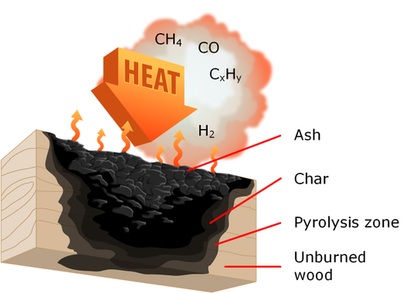

Slide 4
GOAL OF THIS PAPER
Aim of this work is to analyse pyrolysis of wood in the form of pellets in different conditions of heating and to propose a model to interpret the phenomenon by taking into account the effects of the secondary reactions within the solid and heat transfer in the solid.
It is quite common to couple kinetic models developed from very small samples of biomass to energy, mass and sometimes momentum balances in order to simulate the behaviour of large particles.
This is done by making assumptions like secondary reactions are negligible or take place only in gas phase; very low heating rates could be neglected.
But as a consequence of this, kinetic phenomena, especially those connected with secondary pyrolysis, are often hidden by heat transport effects.
For this reason in this work a kinetic model was developed by using experimental data obtained on large particles at very low heating rate. This allowed to highlight the importance of secondary pyrolysis within solid particles.

Slide 5
EXPERIMENTATION
The wood samples were placed in a stainless steel capsule, previously filled by N₂ and the capsule was placed in an oven and heated up.
The capsule is 22 mm internal diameter and 120 mm in length.
Through the upper part of the capsule two thermocouples with 1 mm outer diameter were introduced, the first one was used to measure the temperature at the surface of the sample (T1) and the second one was placed in the centre of the sample (T2).
In order to reduce the problem of heat transfer between biomass and thermocouples , thin thermocouples were used.
The empty oven can reach a maximum heating rate of 5 K/s but in order to obtain a precise control of temperature the maximum temperature rise velocity was limited to 1 K/s.

Slide 6
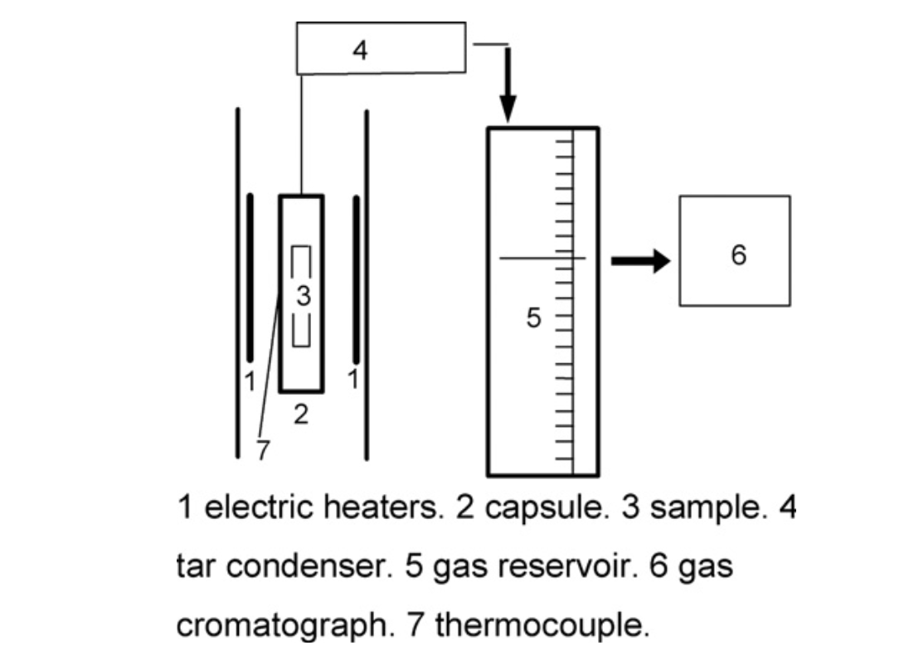

Slide 7
MODEL EQUATIONS

Slide 8
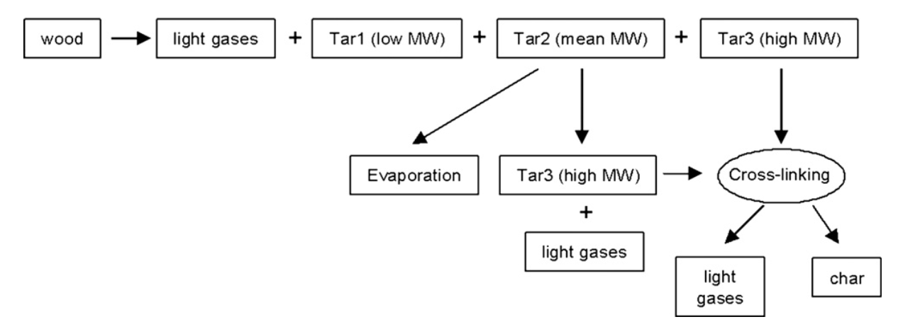
REACTION MECHANISM

Slide 9
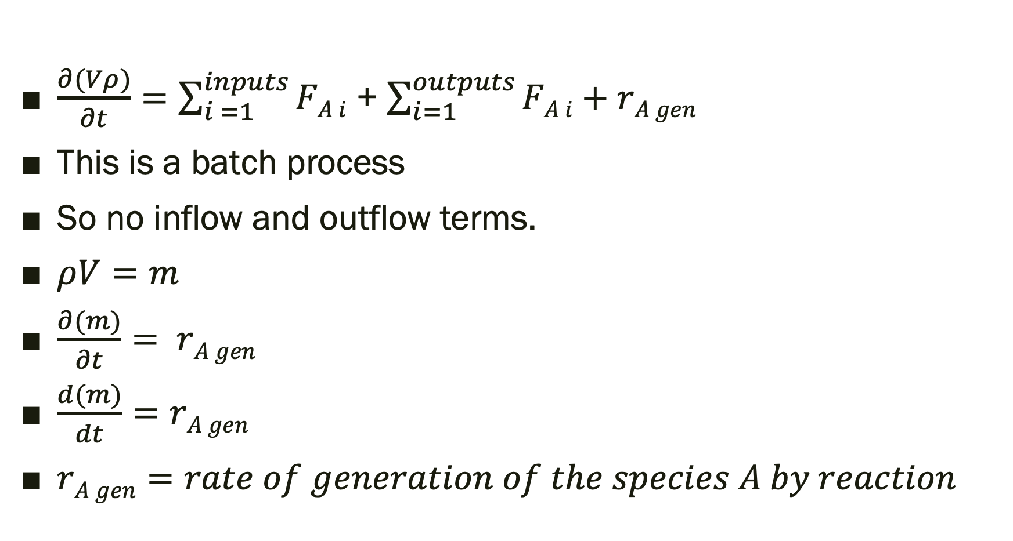
UNSTEADY STATE SPECIES MASS BALANCE EQUATIONS
$\frac{∂(Vρ)}{∂t}=\sum_{i =1}^{inputs}{FA i}$ + $\sum_{i=1}^{outputs}{FA i}+rA gen$
This is a batch process
So no inflow and outflow terms.
$ρV=m$
$\frac{∂(m)}{∂t}= rA gen$
$\frac{d(m)}{dt}=rA gen$
$rA gen=rate of generation of the species A by reaction$

Slide 10

UNSTEADY STATE SPECIES MASS BALANCE EQUATIONS
For wood :
$$\frac{d( mw )}{dt}=−\left(Rg1+R1+R2+R3\right)=− mw Awexp⁡(\frac{−E0}{RT})$$
For gases :
$\dot{m} g=(Rg1+Rg2+Rg3)$
Tar-1:
$\dot{m}1= R1$
Tar-2 :
$\frac{dm2}{dt}+ \dot{m}2 ev=(R2−R23−Rg2)$
Tar-3 :
$\frac{dm3}{dt}=(R3+R23−R4−Rg3)$
Char :
$\frac{dm4}{dt}=R4$

Slide 11

CONSTITUTIVE RELATIONS
$Rg1=−A\frac{dmw}{dt}$
$Rg2=Em2A2exp⁡(\frac{−E2}{RT})$
$Rg3=m3A3gexp⁡(\frac{−E3g}{RT})$
$R1=−B\frac{dmw}{dt}$
$R2=−C\frac{dmw}{dt}$
$R3=−D\frac{dmw}{dt}$
$R23=Fm2A2exp⁡(\frac{−E2}{RT})$

Slide 12
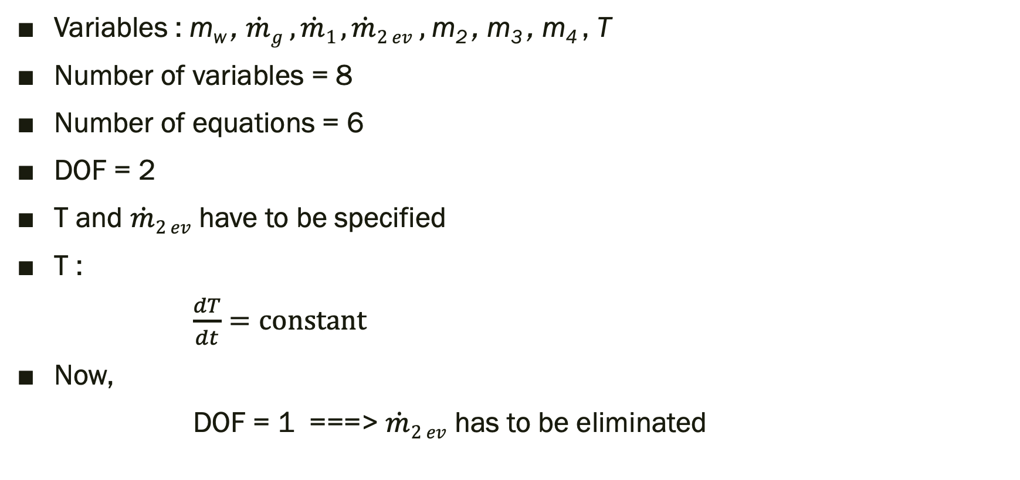
DOF ANALYSIS
Variables : m_{w} , $\dot{m}g ,\dot{m}1 , \dot{m}2 ev ,$m₂ , m₃ , m₄ , T
Number of variables = 8
Number of equations = 6
DOF = 2
T and $\dot{m}2 ev$ have to be specified
T :
$\frac{dT}{dt}=constant$
Now,
DOF = 1 ===> $\dot{m}2 ev$ has to be eliminated

Slide 13
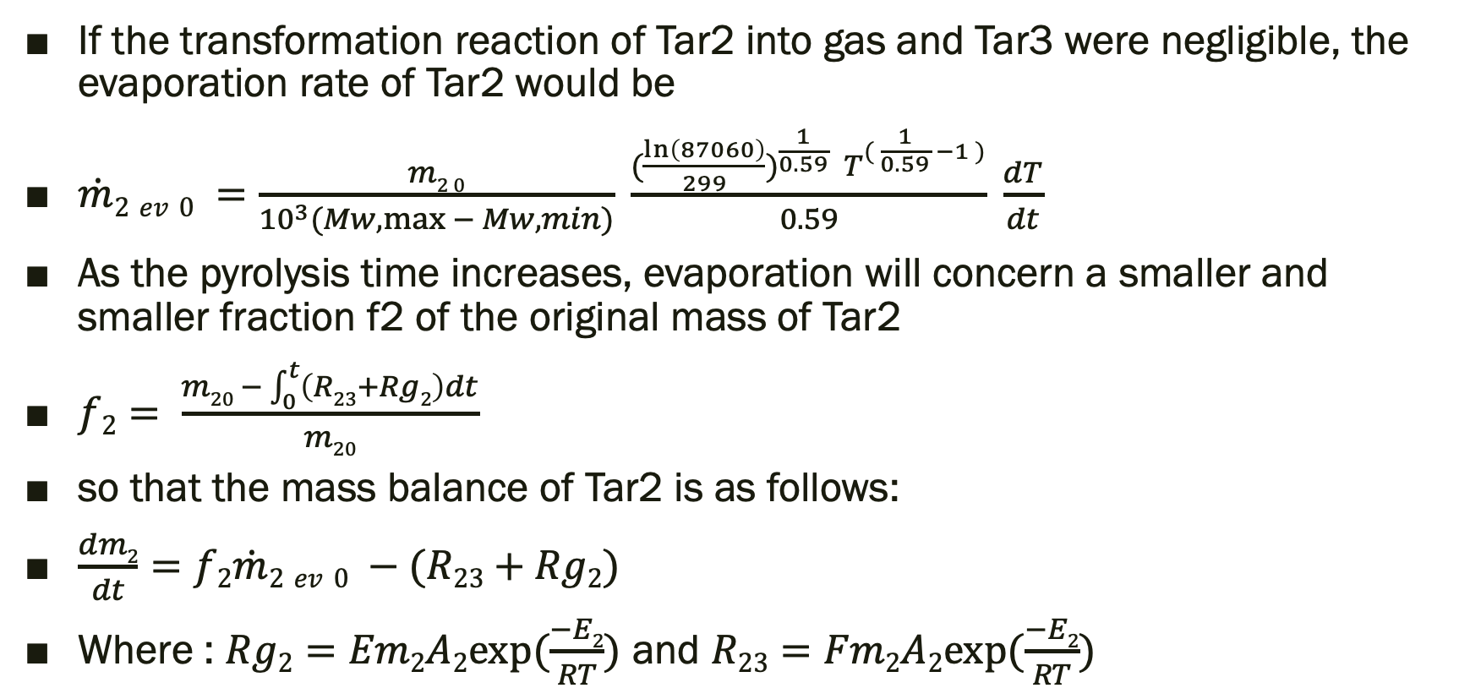

Eliminating $\dot{m}2 ev$
If the transformation reaction of Tar2 into gas and Tar3 were negligible, the evaporation rate of Tar2 would be
$\dot{m}2 ev 0 =\frac{m2 0}{{10}^{3}(Mw,\max{− Mw,min})} \frac{{(\frac{\ln\left(87060\right)}{299})}^{\frac{1}{0.59}} T^{( \frac{1}{0.59} −1 )}}{0.59} \frac{dT}{dt}$
As the pyrolysis time increases, evaporation will concern a smaller and smaller fraction f2 of the original mass of Tar2
$f2= \frac{m20 − \int_{0}^{t}{\left(R23+Rg2\right)dt}}{m20}$
so that the mass balance of Tar2 is as follows:
$\frac{dm2}{dt}=f2\dot{m}2 ev 0 −(R23+Rg2)$
Where : $Rg2=Em2A2exp⁡(\frac{−E2}{RT})$ and $R23=Fm2A2exp⁡(\frac{−E2}{RT})$

Slide 14
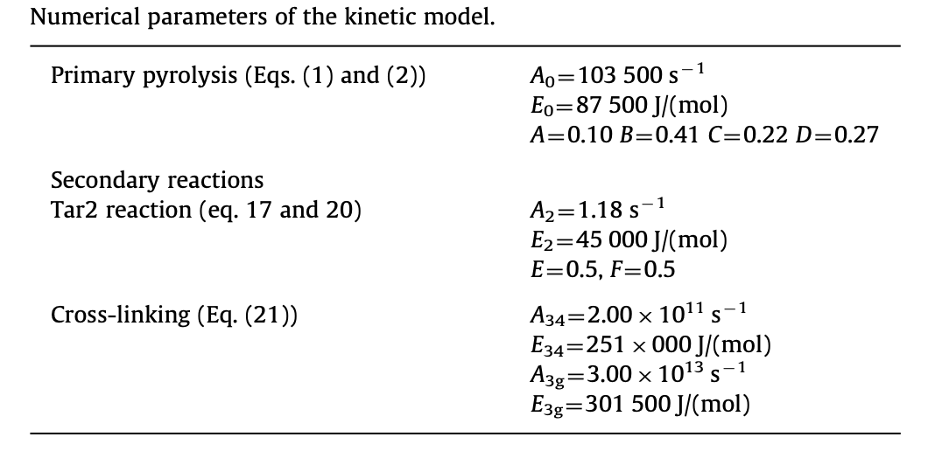
VALUES OF THE CONSTANTS

Slide 15

Results for Beech Wood
m_{w0} = 0.033299 Kg
1st run:
$\frac{dT}{dt}=$0.05K/s
tfinal = 15000s
T0 = 275K
2nd run:
$\frac{dT}{dt}=$1K/s
tfinal = 700s
T0 = 290K

Slide 16
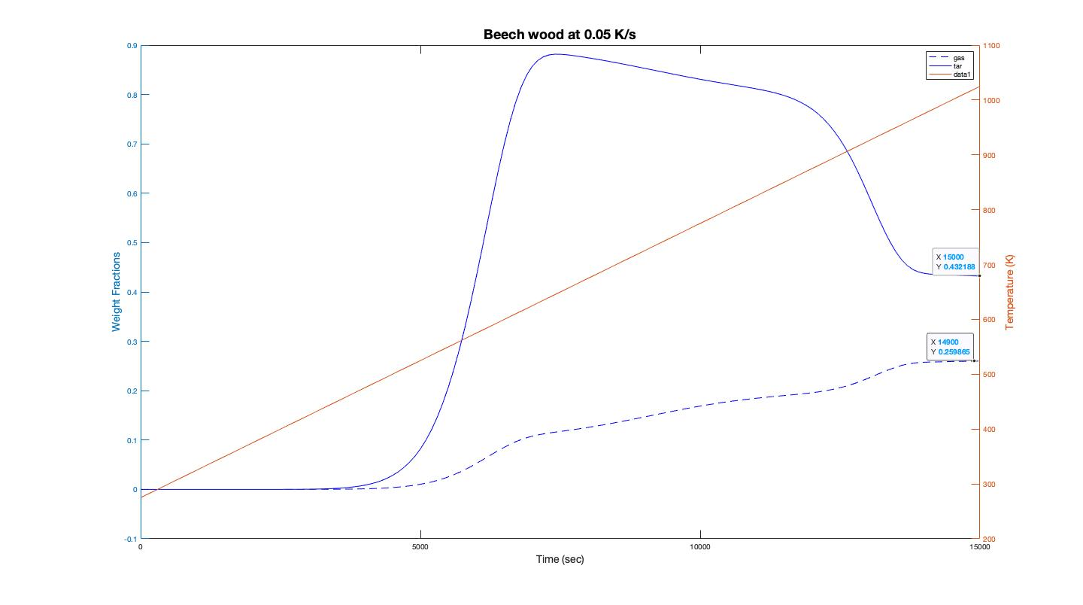

Slide 17
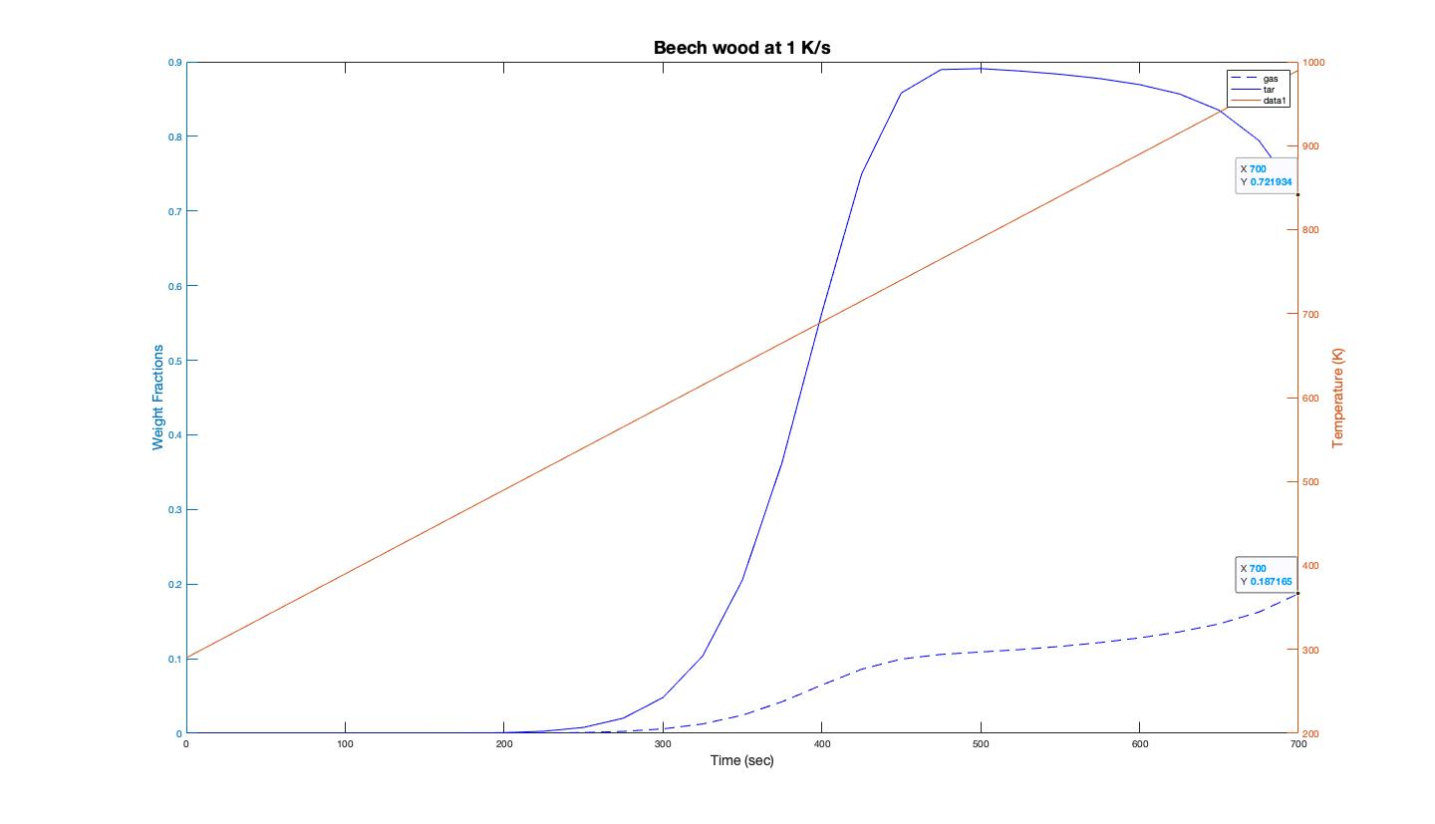

Slide 18

Results for Pine Wood
m_{w0} = 0.023264 Kg
1st run:
$\frac{dT}{dt}=$0.05K/s
tfinal = 15000s
T0 = 275K
2nd run:
$\frac{dT}{dt}=$1K/s
tfinal = 700s
T0 = 290K

Slide 19
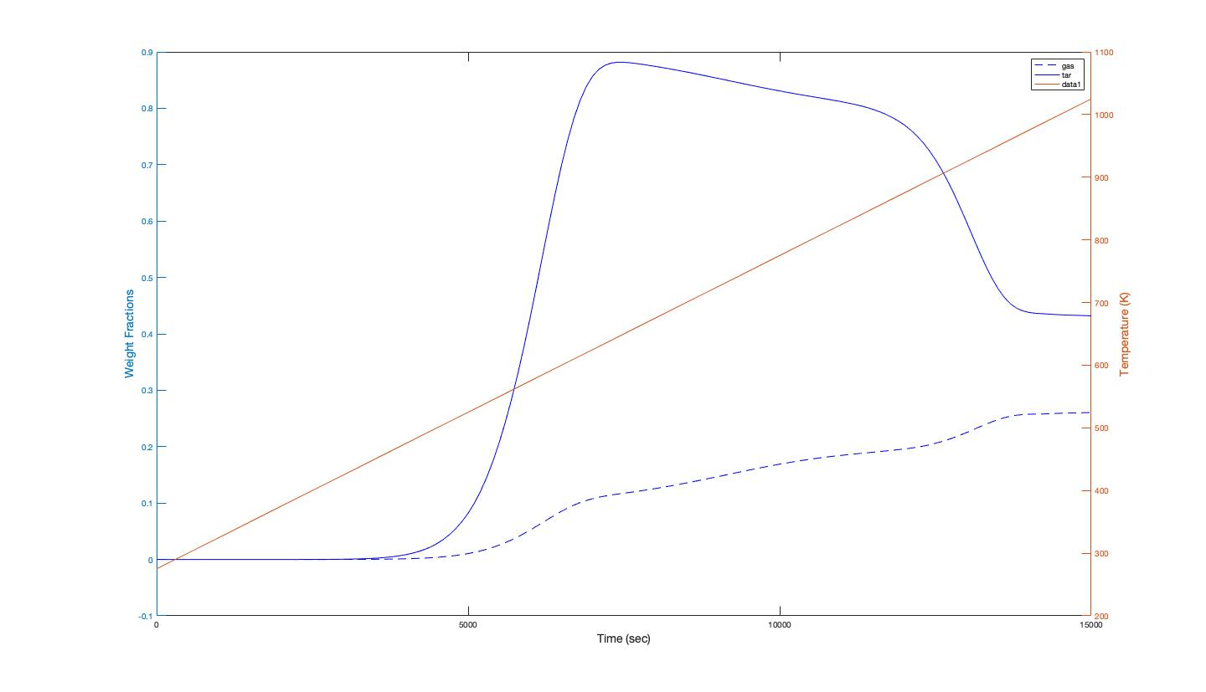

Slide 20


Slide 21
COMPARISION OF THE RESULTS
 | 1 K/S |  |  |  | 0.05 K/S
 | BEECH WOOD |  | PINE WOOD |  | BEECH WOOD |  | PINE WOOD
 | PAPER RESULT | OUR RESULT | PAPER RESULT | OUR RESULT | PAPER RESULT | OUR RESULT | PAPER RESULT | OUR RESULT
GAS | 17% | 18.7% | 18% | 18.72% | 21% |  | 20%
TAR | 62% | 72.19% | 61% | 72.18% | 53% |  | 54%

Slide 22
Large particle pyrolysis
Results of Beech Wood and Pine Wood
Beech wood :
mw0 = 0.033299 Kg
Density of wood = 730 Kg/m³
Pine wood :
mw0 = 0.023264 Kg
Density of wood = 510 Kg/m³

Slide 23
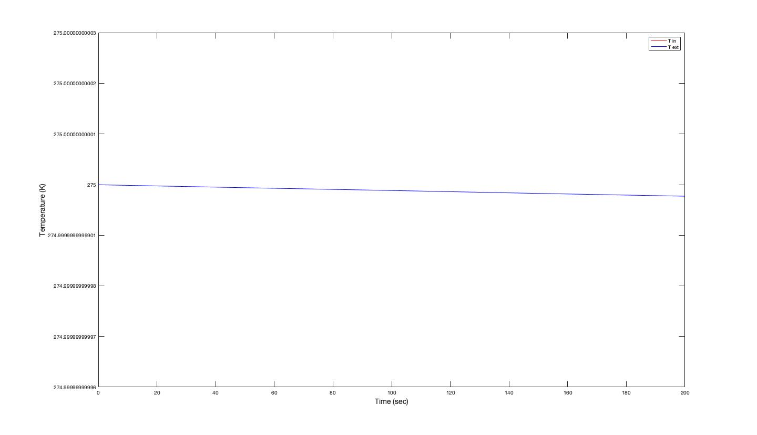

Slide 25
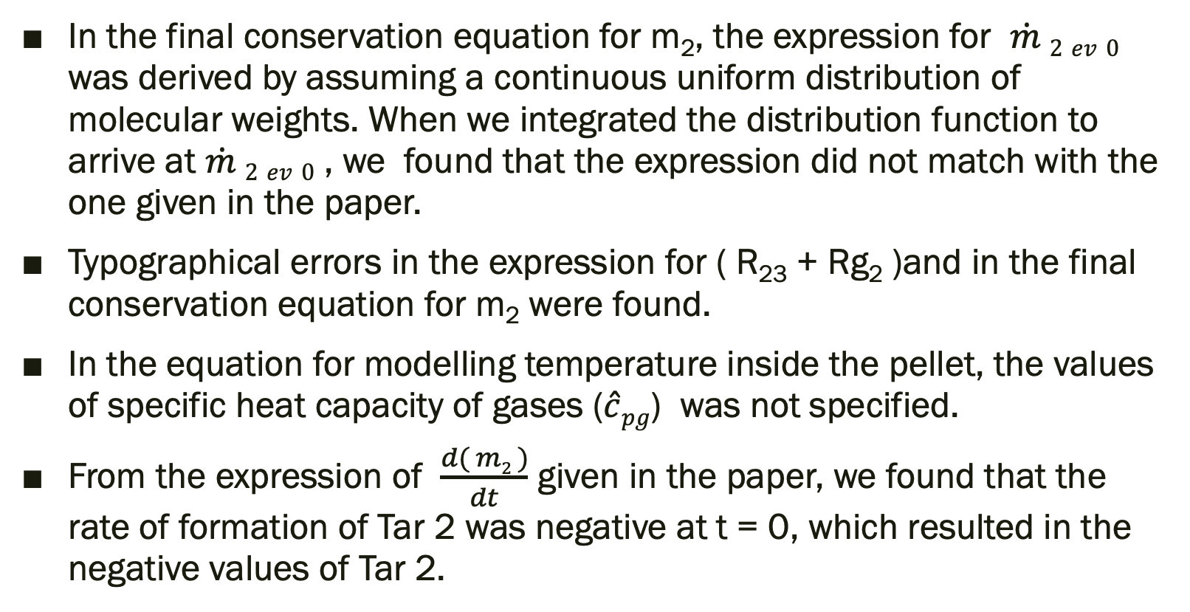
FLAWS IN THE PAPER
In the final conservation equation for m₂, the expression for $\dot{m} 2 ev 0$ was derived by assuming a continuous uniform distribution of molecular weights. When we integrated the distribution function to arrive at $\dot{m} 2 ev 0$ , we found that the expression did not match with the one given in the paper.
Typographical errors in the expression for ( R₂₃ + Rg₂ )and in the final conservation equation for m₂ were found.
In the equation for modelling temperature inside the pellet, the values of specific heat capacity of gases ($\hat{c}pg$) was not specified.
From the expression of $\frac{d( m2 )}{dt}$ given in the paper, we found that the rate of formation of Tar 2 was negative at t = 0, which resulted in the negative values of Tar 2.

